Slide 1

WQD 7003 Data Analytics
CHAPTER 7 – MACHINE LEARNING
Saw Shier Nee, Hema Subramaniam & Aznul Qalid Md Sabri
sawsn@um.edu.my , hema@um.edu.my, aznulqalid@um.edu.my
Dept. of AI, Fac. of Computer Science and IT, University of Malaya
Dept. of SE, Fac. of Computer Science and IT, Universiti Malaya

Slide 2

Outline
Overview and History
Data Terminology
Classification
Regression
Hand-on coding (Lab)

Slide 3
Learning Outcomes
At the end of this lecture, student will be able to:
To explain general concept of machine learning.
To explain machine learning training process
To evaluate the machine learning performance
To implement machine learning model for classification and regression

Slide 4
Machine Learning
Artificial Intelligence
A technique which enables machines to mimic human behaviour
Artificial Intelligence
Machine Learning
Machine Learning
Subset of AI technique which uses statistical methods to enable machines to improve with experience.
Deep Learning
Deep Learning
Subset of Machine Learning which make the computation of multi-layer neural network feasible

Slide 5
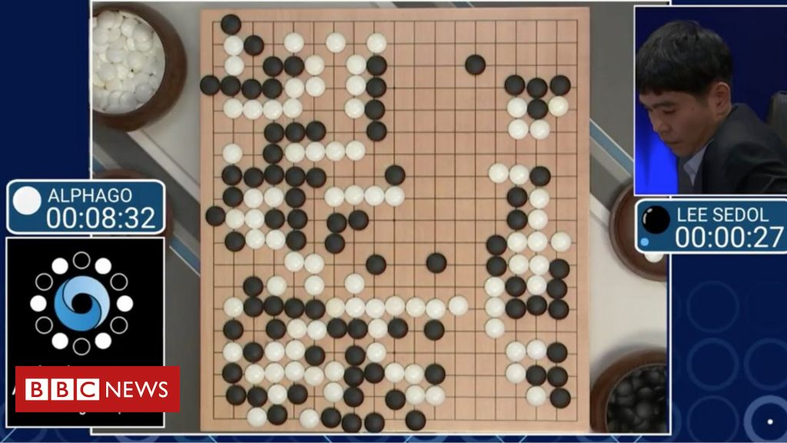
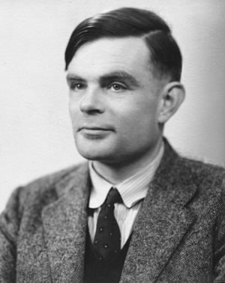
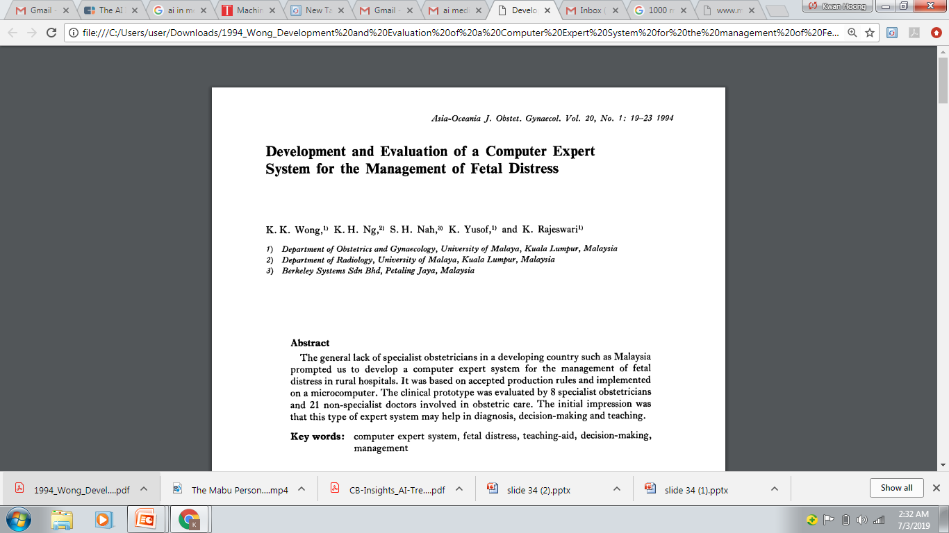
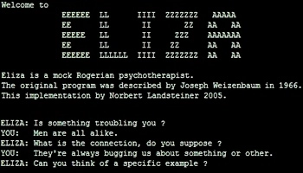

History
“Can machines think?”
Alan Turing introduce a method for machine intelligence
First AI Winter
Second AI Winter
Alpha Go defeated Lee Sedol, world champion of Go
https://www.bbc.com/news/technology-35785875
https://editions.covecollective.org/chronologies/alan-turing-%E2%80%9Ccomputing-machinery-and-intelligence%E2%80%9D-1950
1950
1966
1975
1980
1987
2016
Now
First Chatbot: ELIZA
Expert System
AI in everywhere
https://www.computerhope.com/jargon/e/eliza.htm
Notes:
The history of AI starts very early. In 1950s, at the dawn of computing, Alan Turing asked the question: "Can machines think?“ and he then introduced a method to test machine intelligence. This was at a time when the first general purpose computers had only just been built. In 1966, the first chatbox – ELIZA was built. Unfortunately, AI entered the first winter in 1975 where not much people were interested in such topics and no fundings were available to support this research. In 1980, it started to gain attraction again where expert system were built. In fact, UM also involved in this where they had developed a computer expert system to manage fetal distress. In 1987, AI entered the second winter again because the system was too difficult to maintain, to update and was unable to learn. Until 2016, Alpha GO was announced to defeat Lee Sedol, the world champion of GO. This shows the world how powerful a computer can be. And then, now AI in everywhere, be it in automotive, manufacturing or healthcare.

Slide 6
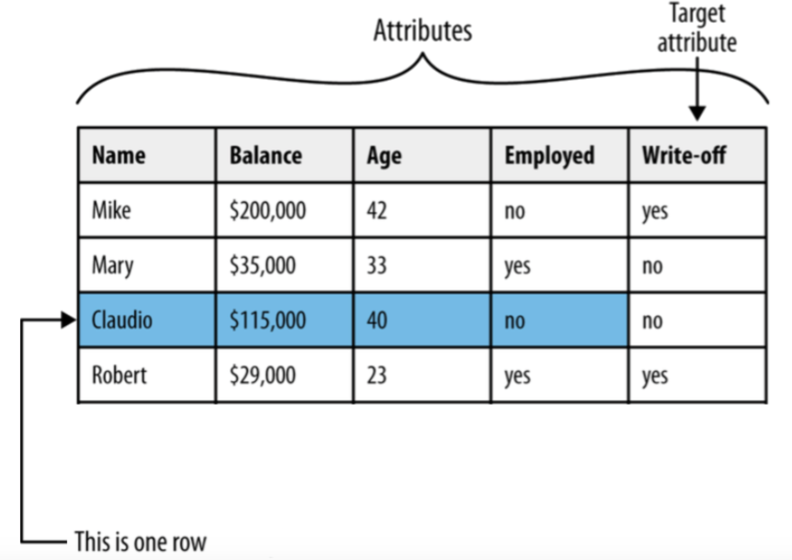
Dataset Terminology

Slide 7
Dataset Terminology
The following terms are used interchangeably:
Row, observation, datapoint
Column, attribute, feature
Target attribute, target, label
A target attribute is one we are interested in predicting

Slide 8
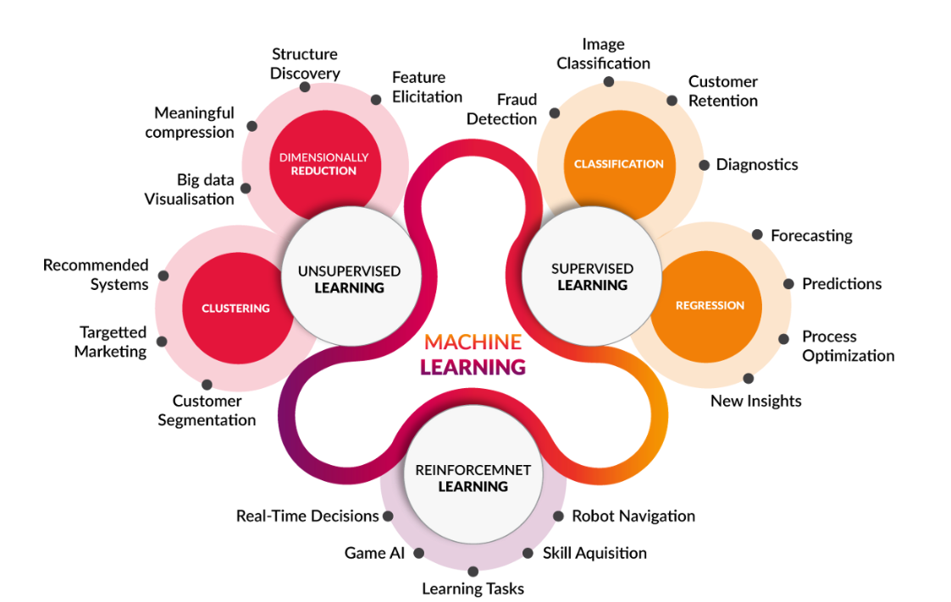
Machine Learning
https://medium.com/@yadavdeepika729/different-machine-learning-models-2387575e64cd

Slide 9
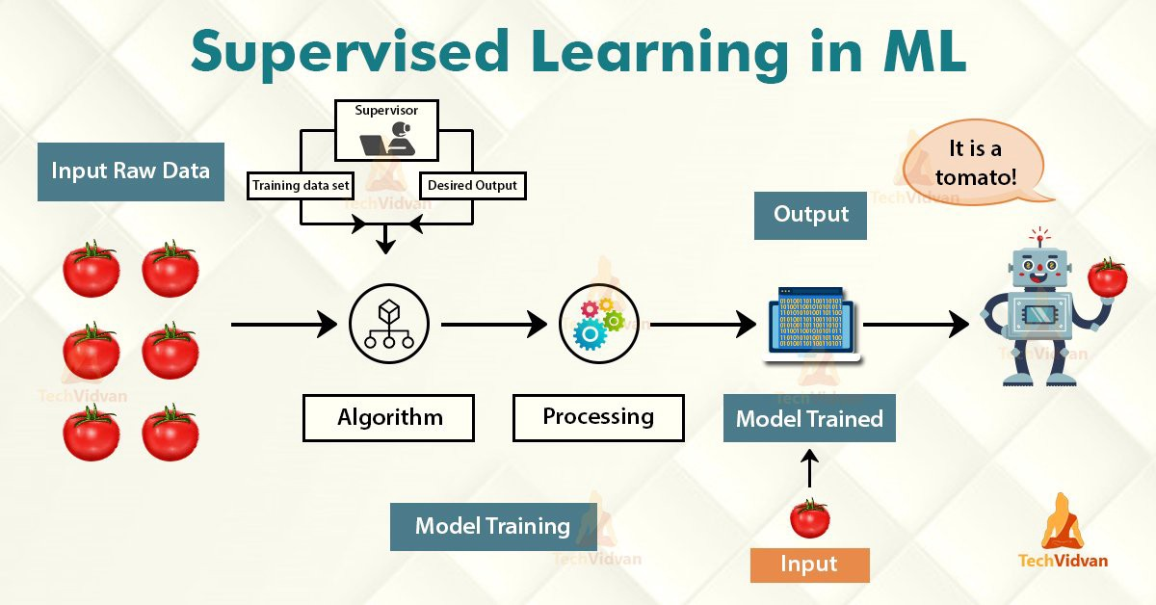
Machine Learning
Have Label
Learn from data pattern
https://medium.com/@yadavdeepika729/different-machine-learning-models-2387575e64cd

Slide 10
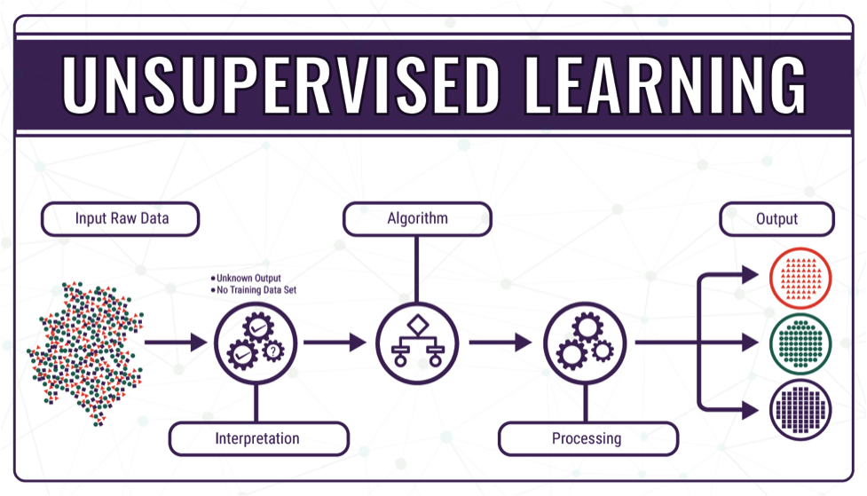
Machine Learning
Do not have label
Group similar data together
https://medium.com/@yadavdeepika729/different-machine-learning-models-2387575e64cd

Slide 11
Machine Learning
https://medium.com/@yadavdeepika729/different-machine-learning-models-2387575e64cd

Slide 12

Classification
Pause and think about some possible example on classification problem.
https://www.springboard.com/blog/data-science/regression-vs-classification/
Notes:
Before go into Machine Learning, we learn on the terminology first.

Slide 13
Classification
Classification is used when the target attribute is a category
Model is built based on target attributes of historical data
Examples: – Predicting churn – Predicting write-off
Notes:
Before go into Machine Learning, we learn on the terminology first.
Churn rate, sometimes known as attrition rate, is the rate at which customers stop doing business with a company over a given period of time.

Slide 14
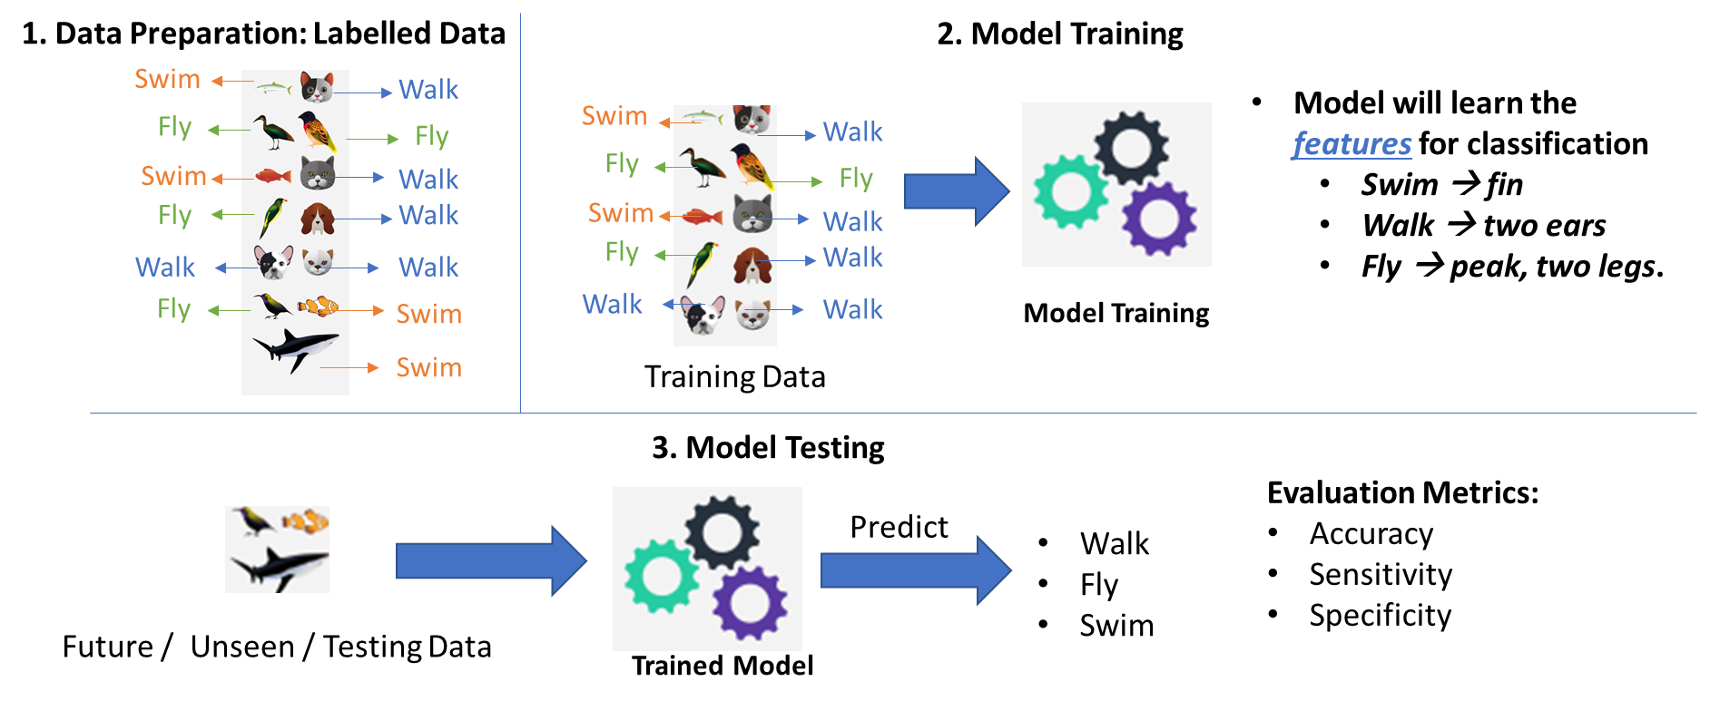
Classification – Developing ML model

Slide 15
Classification – Developing ML model
Data Preparation
Data Splitting (Train/Test)
Data | Feature1 | Feature2 | Prediction | Label
Data1 | 23 | 3 |  | Cold
Data2 | 12 | 51 |  | Hot
Data3 | 1 | 12 |  | Hot
… | … | … |  | …
DataN | 15 | 65 |  | Cold
Model Training
Model Evaluation

Slide 16
Classification – Developing ML model
Data Preparation
Data Splitting (Train/Test)
Data | Feature1 | Feature2 | Prediction | Label
Data1 | 23 | 3 |  | Cold
Data2 | 12 | 51 |  | Hot
Data3 | 1 | 12 |  | Hot
… | … | … |  | …
DataN | 15 | 65 |  | Cold
70%
Training
Model Training
30%
Test
Model Evaluation

Slide 17
Classification – Developing ML model
Data Preparation
Use only training data to train the model
Data Splitting (Train/Test)
Data | Feature1 | Feature2 | Prediction | Label
Data1 | 23 | 3 |  | Cold
Data2 | 12 | 51 |  | Hot
Data3 | 1 | 12 |  | Hot
… | … | … |  | …
DataN | 15 | 65 |  | Cold
70%
Training
Model Training
Model Evaluation

Slide 18
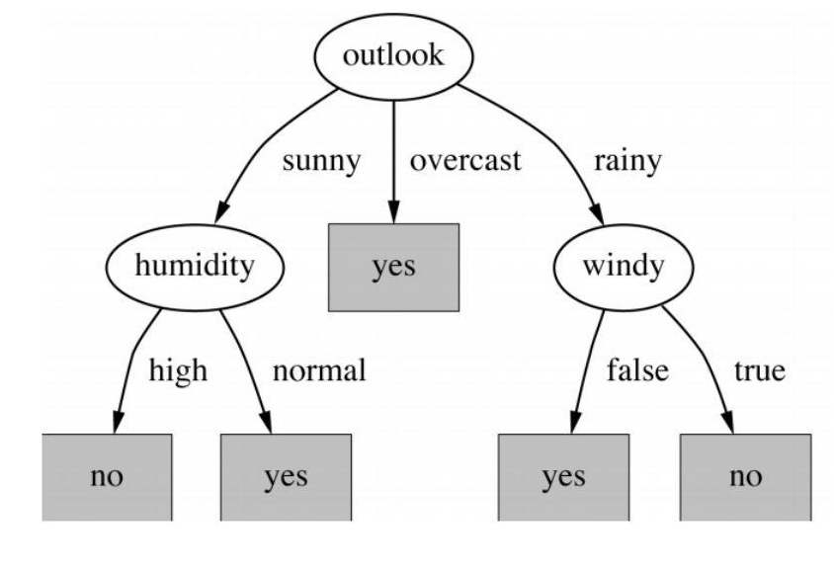
Classification – Developing ML model
Data Preparation
Example of decision tree
Data Splitting (Train/Test)
Model Training
Model Evaluation

Slide 19
ML Model – Classifiers Evaluation Metrics
Data Preparation
Use only testing data to evaluate the model
Data Splitting (Train/Test)
Data | Feature1 | Feature2 | Prediction | Label
Data1 | 23 | 3 | Cold | Cold
Data2 | 12 | 51 | Cold | Hot
Data3 | 1 | 12 | Hot | Hot
… | … | … | … | …
DataN | 15 | 65 | Hot | Cold
Model Training
30%
Test
Model Evaluation
https://en.wikipedia.org/wiki/Confusion_matrix

Slide 20
ML Model – Classifiers Evaluation Metrics
Data Preparation
A perfect model should predict all testing data correctly → Accuracy = 100%
Data Splitting (Train/Test)
Data | Feature1 | Feature2 | Prediction | Label
Data1 | 23 | 3 | Cold | Cold
Data2 | 12 | 51 | Cold | Hot
Data3 | 1 | 12 | Hot | Hot
… | … | … | … | …
DataN | 15 | 65 | Hot | Cold
Model Training
30%
Test
Model Evaluation
https://en.wikipedia.org/wiki/Confusion_matrix

Slide 21
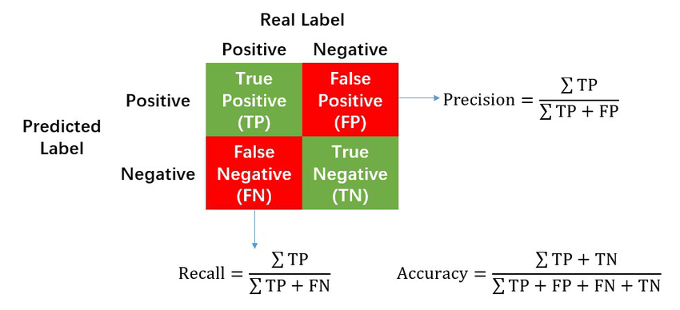
ML Model – Classifiers Evaluation Metrics
Data Preparation
Confusion Matrix
Data Splitting (Train/Test)
Model Training
Model Evaluation
https://en.wikipedia.org/wiki/Confusion_matrix

Slide 22
ML Model – Classifiers Evaluation Metrics
Accuracy: How many % of predicted cases are correct.
Precision: How many % of predicted positive cases are actually positive
Recall: How many % of positive cases did the classifier predict as positive?
F measure (F₁ or F-score): harmonic mean of precision and recall.
Perfect score is 1.0

Slide 23
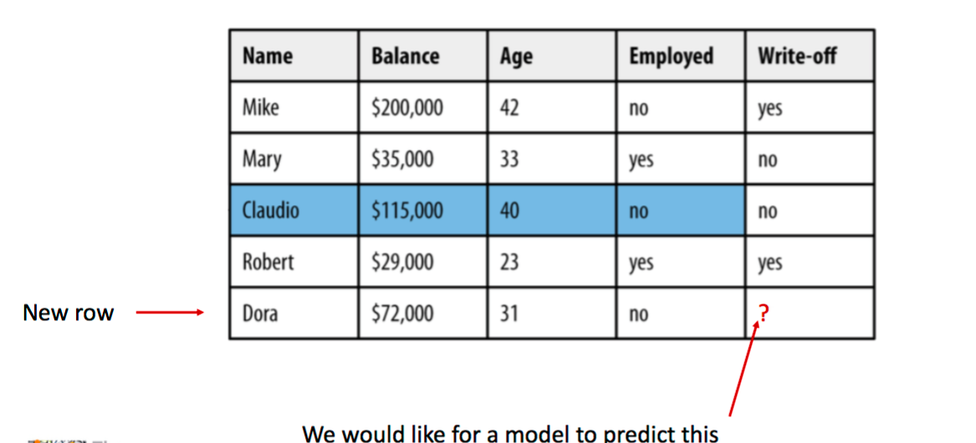
Classification - Example

Slide 24
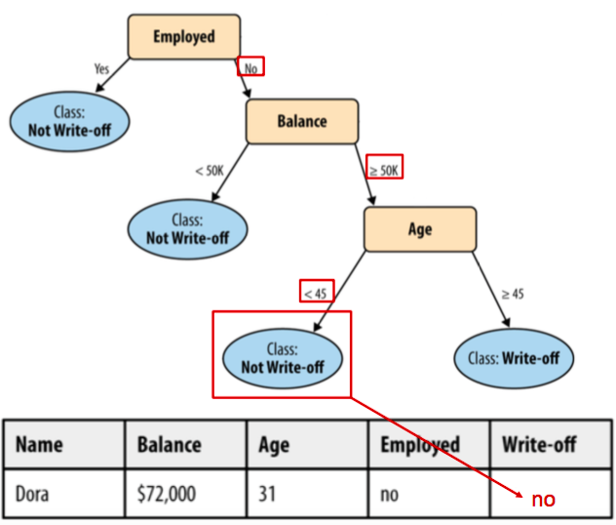
Classification – Decision Tree

Slide 25
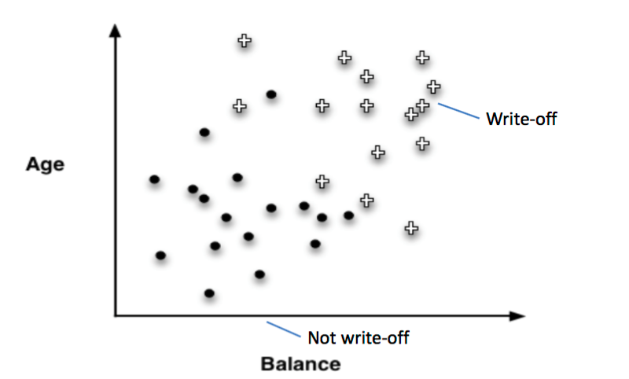
Classification – Results Visualization

Slide 26
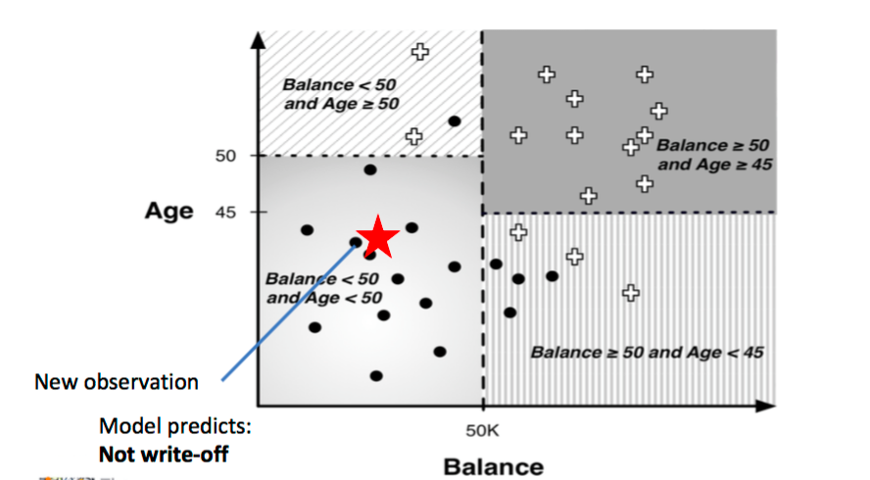
Classification – Results Visualization

Slide 27
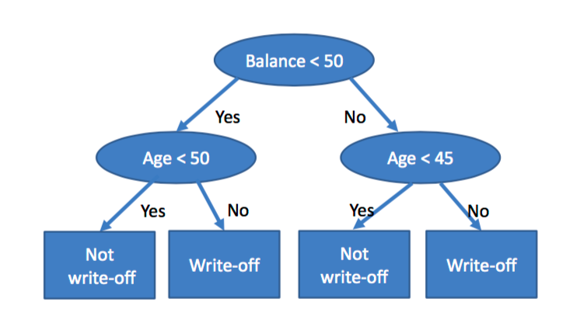
Corresponding Decision Tree

Slide 28
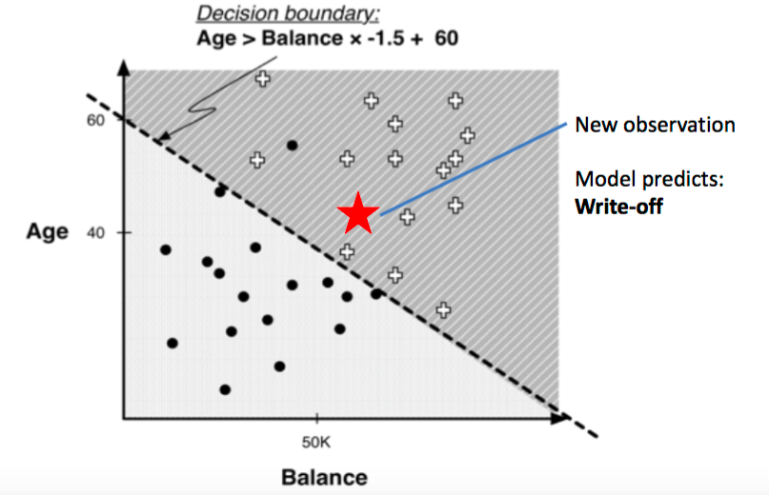
Results Visualization – Linear Classifier

Slide 29
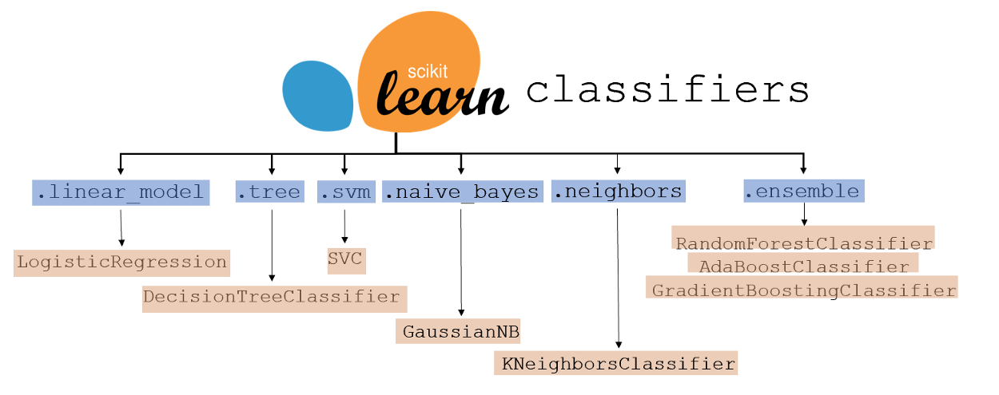
ML Model – Other types of classifiers
https://www.kdnuggets.com/2021/01/ultimate-scikit-learn-machine-learning-cheatsheet.html

Slide 30
Machine Learning
https://medium.com/@yadavdeepika729/different-machine-learning-models-2387575e64cd

Slide 31
Regression
Pause and think about some possible example on regression problem.
https://www.springboard.com/blog/data-science/regression-vs-classification/
Notes:
Before go into Machine Learning, we learn on the terminology first.

Slide 32
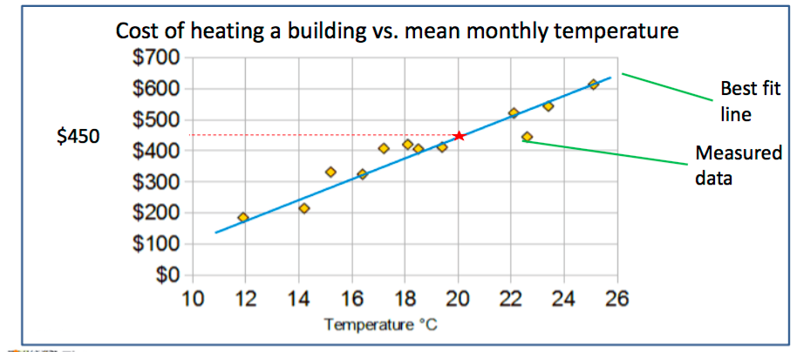
Regression
Regression predicts a target attribute which is a number (as opposed to a category)
The simplest regression is a best fit line
Notes:
Before go into Machine Learning, we learn on the terminology first.

Slide 33
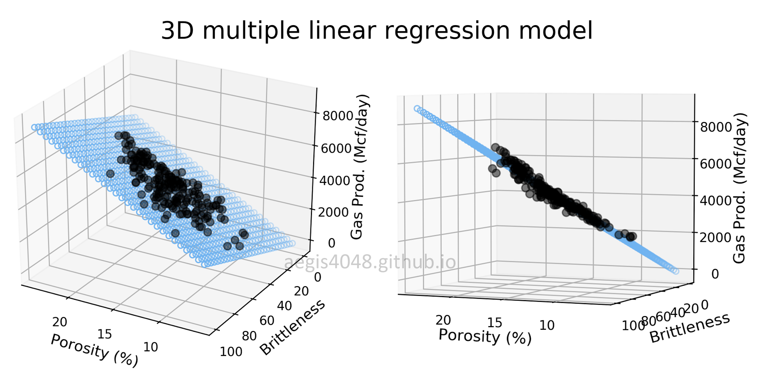
Regression
https://aegis4048.github.io/mutiple_linear_regression_and_visualization_in_python

Slide 34
Regression – Developing ML model
Data Preparation
Data Splitting (Train/Test)
Data | Feature1 | Feature2 | Prediction | Temp.
Data1 | 23 | 3 |  | 32
Data2 | 12 | 51 |  | 29
Data3 | 1 | 12 |  | 24
… | … | … |  | …
DataN | 15 | 65 |  | 38
Model Training
Model Evaluation

Slide 35
Regression – Developing ML model
Data Preparation
Data Splitting (Train/Test)
Data | Feature1 | Feature2 | Prediction | Temp.
Data1 | 23 | 3 |  | 32
Data2 | 12 | 51 |  | 29
Data3 | 1 | 12 |  | 24
… | … | … |  | …
DataN | 15 | 65 |  | 38
70%
Training
Model Training
30%
Test
Model Evaluation

Slide 36
Regression – Developing ML model
Data Preparation
Use only training data to train the model
Data Splitting (Train/Test)
Data | Feature1 | Feature2 | Prediction | Temp.
Data1 | 23 | 3 |  | 32
Data2 | 12 | 51 |  | 29
Data3 | 1 | 12 |  | 24
… | … | … |  | …
DataN | 15 | 65 |  | 38
70%
Training
Model Training
Model Evaluation

Slide 37
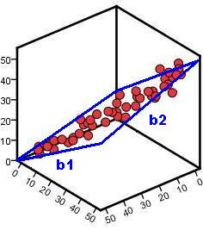
Regression – Developing ML model
Data Preparation
Example of linear regression
Data Splitting (Train/Test)
Temperature
Model Training
Model Evaluation
Feature 1
Feature 2

Slide 38
ML Model – Regression Evaluation Metrics
Data Preparation
Use only testing data to evaluate the model
Data Splitting (Train/Test)
Data | Feature1 | Feature2 | Prediction | Label
Data1 | 23 | 3 | 34 | 32
Data2 | 12 | 51 | 31 | 29
Data3 | 1 | 12 | 26 | 24
… | … | … | … | …
DataN | 15 | 65 | 35 | 38
Model Training
30%
Test
Model Evaluation
https://en.wikipedia.org/wiki/Confusion_matrix

Slide 39
ML Model – Regression Evaluation Metrics
Data Preparation
A perfect model should predict all testing data correctly→ Mean Square Error = 0
Data Splitting (Train/Test)
Data | Feature1 | Feature2 | Prediction | Label
Data1 | 23 | 3 | 34 | 32
Data2 | 12 | 51 | 31 | 29
Data3 | 1 | 12 | 26 | 24
… | … | … | … | …
DataN | 15 | 65 | 35 | 38
Model Training
30%
Test
Model Evaluation

Slide 40
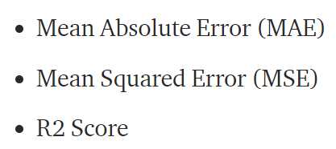
ML Model – Regression Evaluation Metrics
Data Preparation
Data Splitting (Train/Test)
Model Training
Model Evaluation
https://medium.com/@parag.jain164/performance-matrix-for-regression-model-c9ba0d2cae33

Slide 41
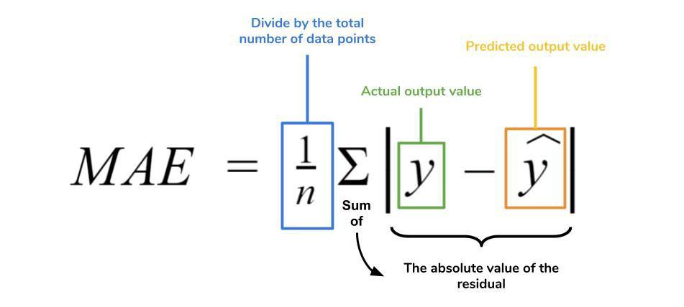
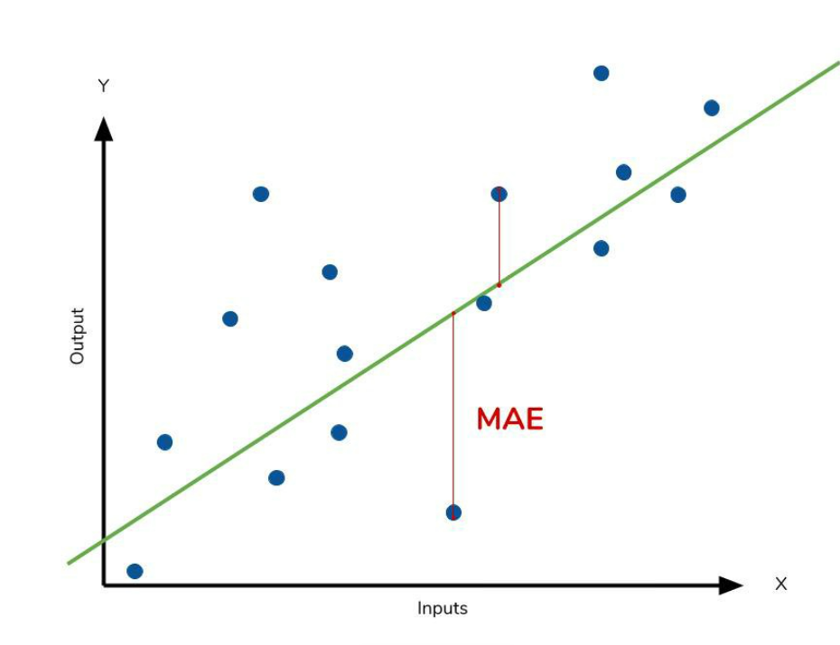
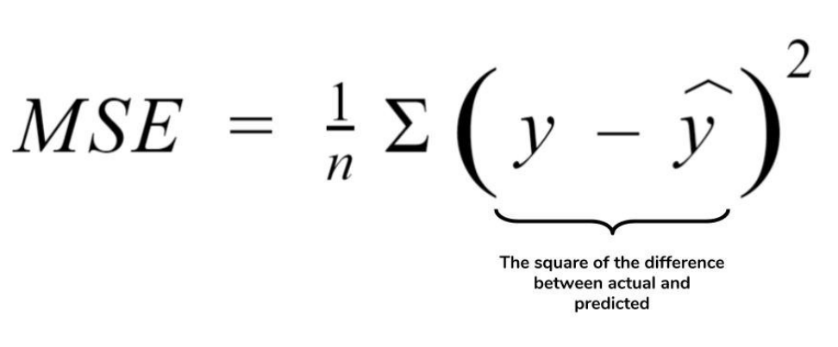
ML Model – Regression Evaluation Metrics
Data Preparation
Data Splitting (Train/Test)
Model Training
Model Evaluation
https://medium.com/ml-cheat-sheet/machine-learning-evaluation-metrics-b89b8832e275

Slide 42
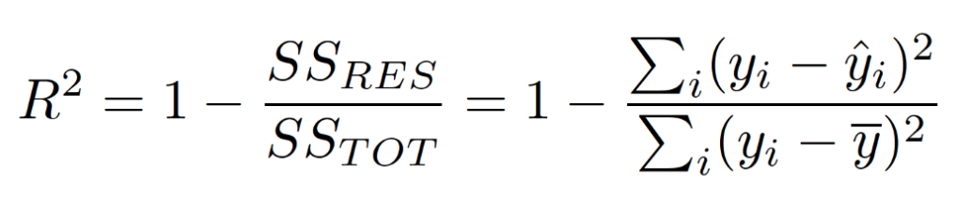
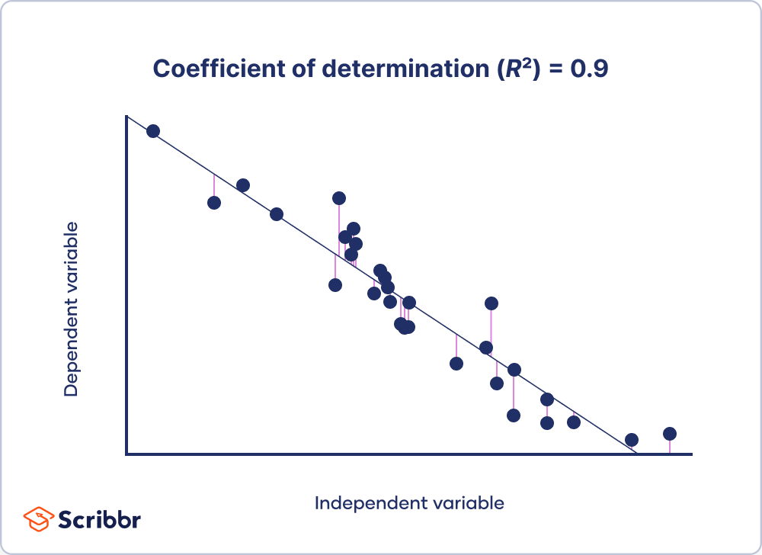
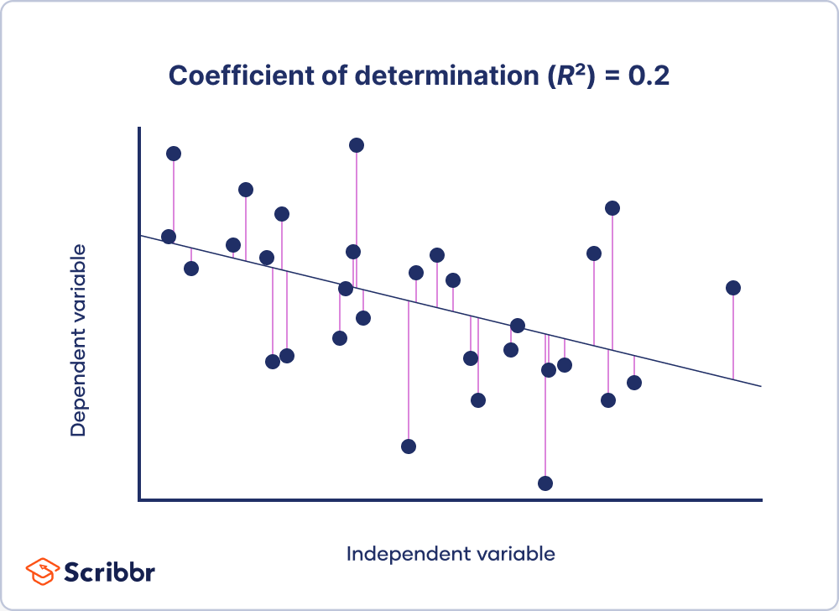
ML Model – Regression Evaluation Metrics
Data Preparation
Data Splitting (Train/Test)
Model Training
Model Evaluation
https://www.scribbr.com/statistics/coefficient-of-determination/

Slide 43
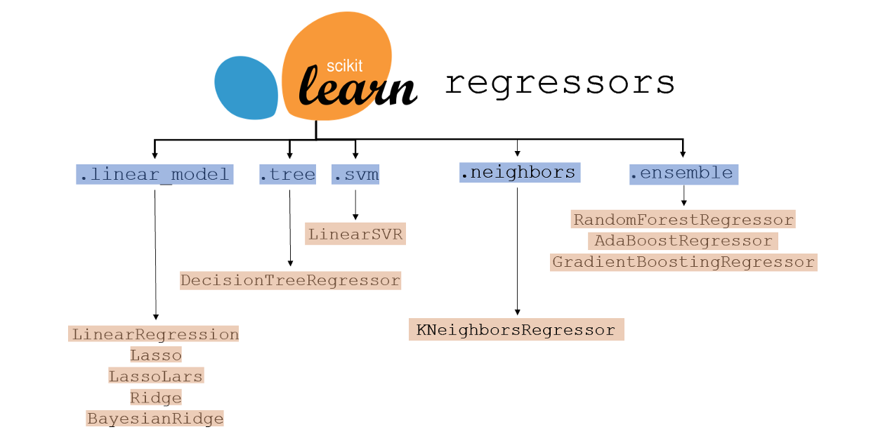
ML Model – Other types of regressor
https://www.kdnuggets.com/2021/01/ultimate-scikit-learn-machine-learning-cheatsheet.html

Slide 44
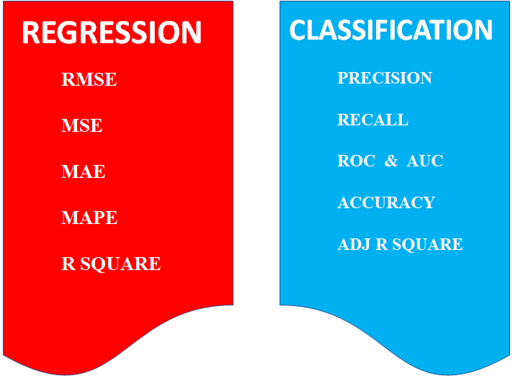
ML Model – Evaluation Metrics
https://medium.com/odscjournal/are-we-choosing-the-right-evaluation-metrics-how-to-choose-it-ee01fcf34b9

Slide 45
Corresponding Code
Data Preparation
pd.read_csv()
Data Splitting (Train/Test)
sklearn.model_selection.train_test_split()
Model Training
model.fit()
Model Evaluation
model.predict()

